Slide 1





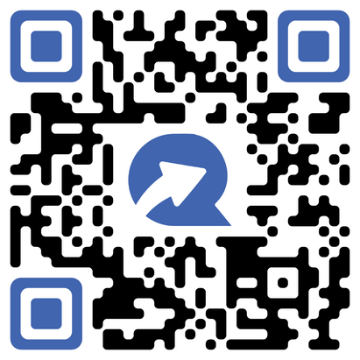


C A S H B A C K
$5
PER BOTTLE
G E T P A I D I N 48 H O U R S !
SUBMIT RECEIPTS AND EARN CASH BACK
SCAN OR TEXT
UNCLENEAREST
^{TO} 37293
SEE BACKSIDE FOR DETAILS OFFER EXPIRES 08/31/26
GET PAID IN
48 HOURS!

Slide 2



SUBMIT RECEIPTS AND GET PAID IN 48 HOURS!
REBATE OFFER TERMS & CONDITIONS
Valid on purchases made by individuals 21 years of age or older in the states of AL, AK, AZ, AR, CA, CO, CT, DC, DE, FL, GA, ID, IL, IA, KS, KY, ME, MD, MA, MI, MN, MS, MO, MT, NE, NV, NH, NJ, NM, NY, NC, ND, OH, OK, OR, PA, RI, SC, SD,
TN, VT, VA, WA, WV, WI, and WY between June 1, 2026 and August 31, 2026. Receipts must be submitted no later than September 10, 2026.
Purchases must be made in a single transaction on one receipt. The offer applies only to Nearest Green Tennessee Whiskey 750ml
Purchase one (1) qualifying 750 ml bottle of Nearest Green Tennessee Whiskey and get $5 cash back.
Offer may not be purchased, sold, or transferred and is void upon redemption. All applicable taxes remain the responsibility of the consumer. Offer is not available to employees, officers, or directors of Uncle Nearest, Inc., their immediate family members, affiliated companies, or licensed alcohol beverage wholesalers or retailers. TextRebates reserves the right to request additional information prior to honoring any rebate request and to reject non-conforming submissions without liability. Offer void where prohibited, taxed, or otherwise restricted by law. Subject to TextRebates Terms of Use: www.textrebates.com/rebateterms. For rebate status or inquiries, email: info@textrebates.com.
PLEASE ENJOY OUR PRODUCTS RESPONSIBLY
© 2026 Uncle Nearest, Inc. Shelbyville, TN, 37160
SCAN OR TEXT
UNCLENEAREST
TO 37293
Powered by

